Slide 1

DSA Orientation

Slide 2
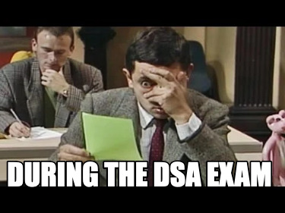
DSA ROUNDS 🥲

Slide 3
NEXT 6 MONTHS >>> DSA

Slide 4
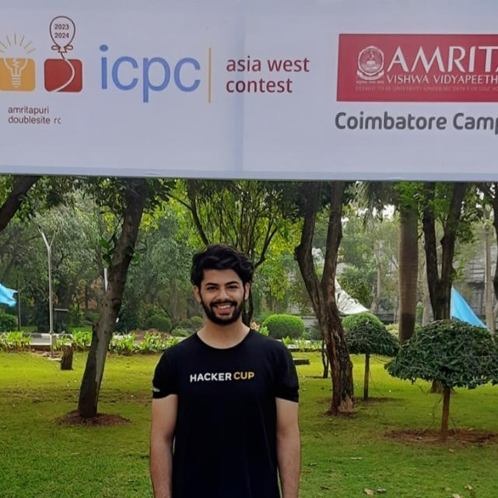


ABOUT ME
Lead Instructor - 100xSchool
Ex - Scaler, Achieve.ai, Unacademy, Coding Ninjas
Candidate Master Codeforces (2000+)
6★ Codechef (2200+)
Top 0.07% LeetCode (2700+)
2x ICPC Regionalist (2022, 2023)
DhruvPasricha
_DhruvPasricha

Slide 5
SYLLABUS
Introduction to C++
Loops and Pattern Printing
Arrays / 2D Arrays
Strings
Sorting and Searching
Pointers / Pass by val, ref & add
Time and Space Complexity
Sets and Maps
Prefix Sums, Sliding Window, Contribution
Bit Manipulation
Number Theory Basics
Recursion and Backtracking
Two Pointers
Linked List
Stack / Queue / Deque
Binary Tree / BST
Priority Queue / Heap
Trie
Greedy
Dynamic Programming
Graphs
Segment Tree / Ordered Set

Slide 6
WHAT’S THE PLAN?
Class
One live class per week, Thursday: 8 PM - 10 PM
Assignments
Practice problems after every class. (Codeforces / Leetcode)
Contest
Practice contest after every 2 weeks, Wednesday: 8 PM - 10 PM

Slide 7
EXPECTATIONS
Be Consistent
Attend every class and complete the assignments sincerely.
Ask for Help
If you're stuck, don’t stay silent. Post your doubts in the discord.
Prioritize Revision
Maintain a revision doc and solved problems sheet – this is crucial for long-term retention.

Slide 8
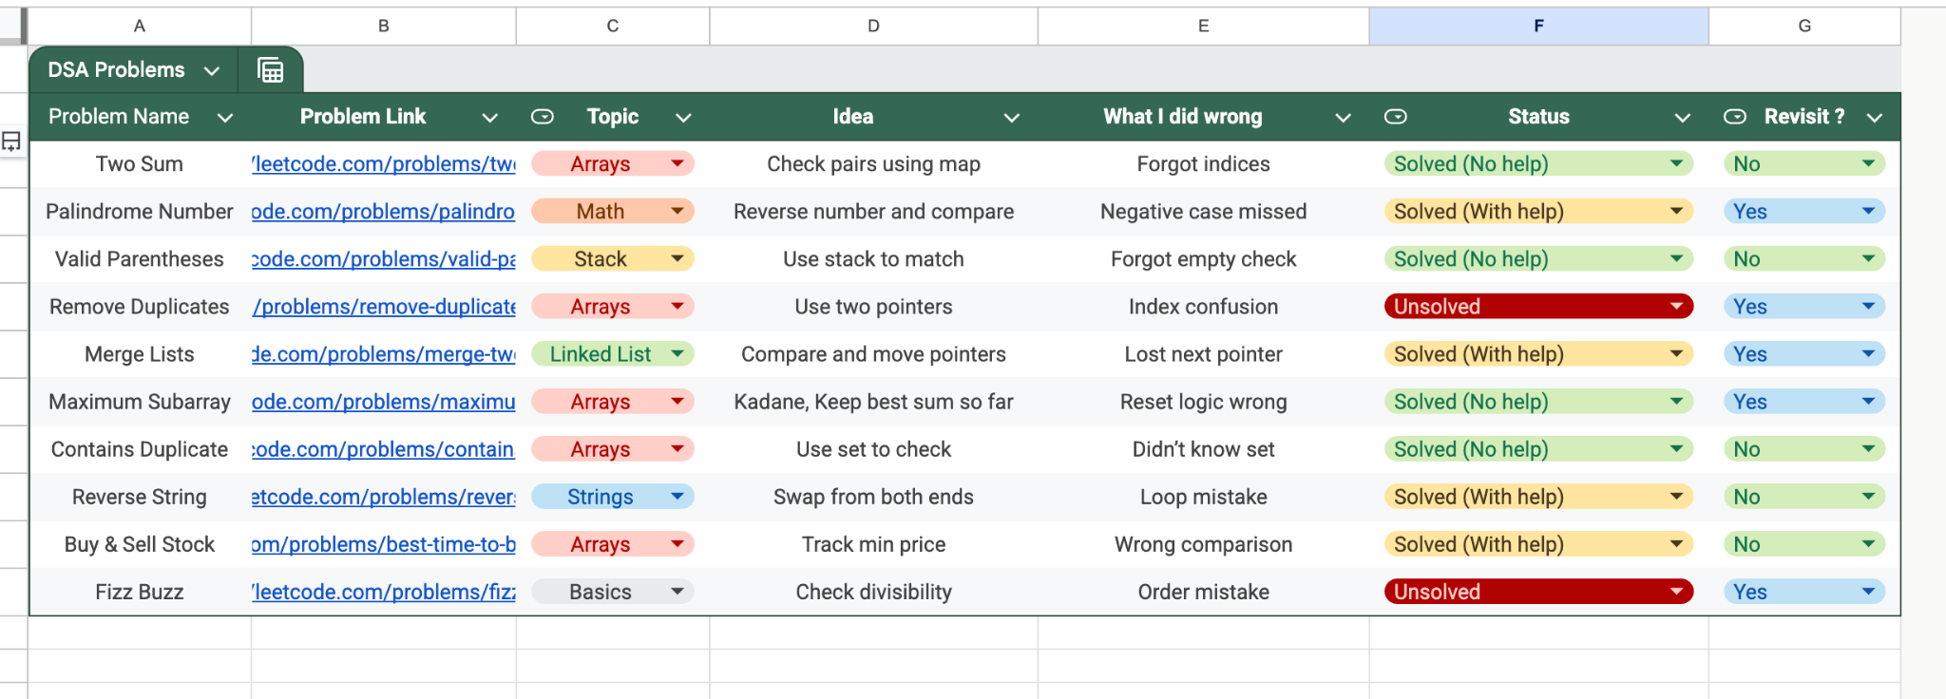
SAMPLE REVISION SHEET

Slide 9
COMMON MISTAKES TO AVOID
START CODING WITHOUT HAVING A SOLUTION IN MIND.
COMPARING YOUR PROGRESS WITH OTHERS.
CHASING SHEETS INSTEAD OF UNDERSTANDING.
GIVING UP TOO EARLY.

Slide 10


Slide 11
1) Codeforces Div 3 and 4 contest
2) Atcoder beginner contest
3) Leetcode weekly and biweekly contests

